Slide 1
‘optimisation of coal mill systems, with fire and explosion protection’
24 - 25 April 2017, London, UK
Vincent Grosskopf, Coal Mill Safety Pte Ltd
Instead of coal please read any solid fuel wherever applicable.
The slides of this presentation partly run by themselves.
Where action is needed for continuation prompter appears.

Slide 2
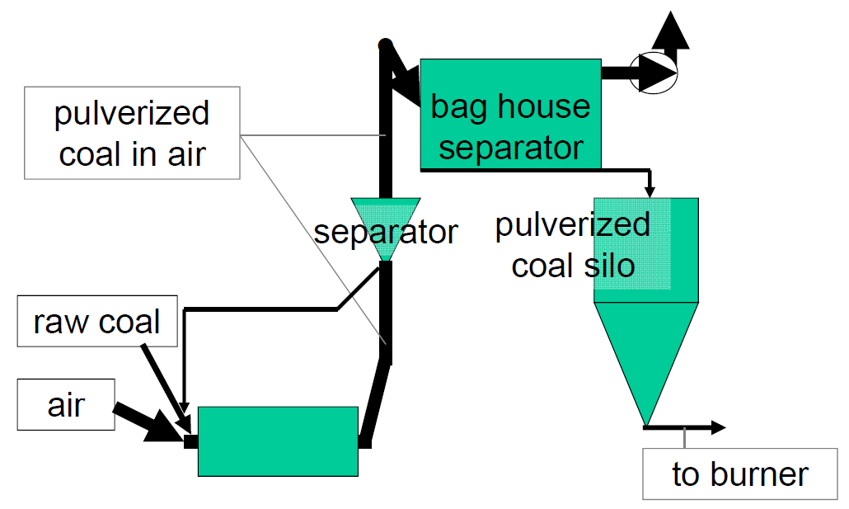
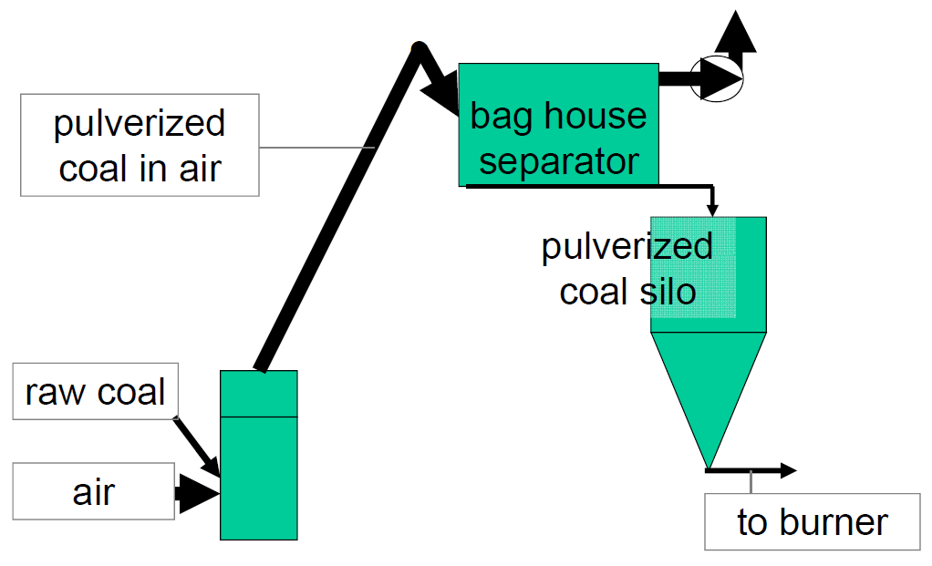
In order for all of us to be on the same page:
This talk pertains to indirect firing systems in form of air-swept mill systems, both horizontal ball mill and vertical roller mill systems.
horizontal ball mill
vertical roller mill

Slide 3
What this is about₁
Where do coal (or fuel) grinding systems need optimisation?
Grinding systems for fuel normally are not the source of cement process engineers’ or mill manufacturers’ pride.
Although, over the last decades, mills and other relevant equipment have been developed further, the typical layouts of a coal mill systems today will not be so different from those built 30 or even 40 years ago.
An important reason for this is that it is normal for a supplier to look in his drawers for designs realised in the past, which, certainly for the supplier, is the most cost effective way to get the job done.

Slide 4
What this is about₂
Where do coal (or fuel) grinding systems need optimisation?
Such systems comprise some key equipment and lots of concrete (civil engineering) and steel, for which the realisation costs normally are NOT borne by the supplier.
Once the supplier has been selected and the system’s concept has been agreed upon, it is no longer possible to change larger portions of the layout of the system.
An “old” system will be built again. To change it would increase the costs and the time needed for the realisation.
and optimisation
in system design have come to a halt.
This is how innovation in system design has come to a halt.

Slide 5
What can be optimised?
1
Raw coal movement from the yard to the grinding process. Not much can be done to optimise the movement of material.
About the fire and explosion protection we have to speak.
2
Between raw coal silo and fine coal (PF) silo(s) we have the process. Things can be optimised, compared with what is being done since 30 years.
Again, about the fire and explosion protection we have to speak.
3
The intermediate storage in (a) PF silo(s)
also needs to be looked into.
Fire and explosion protection there definitely is a topic.

Slide 6
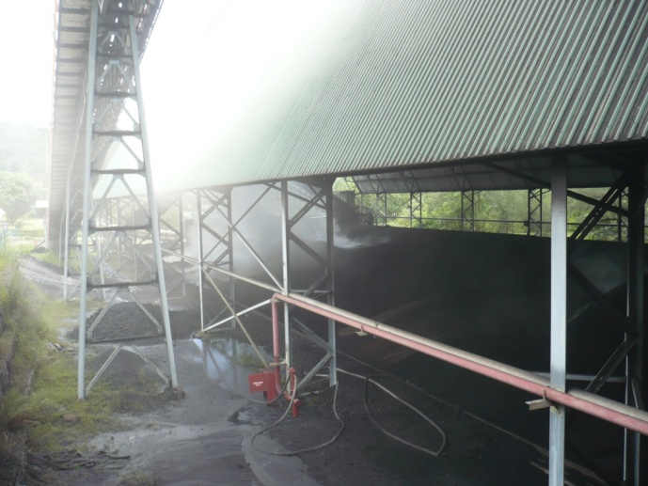
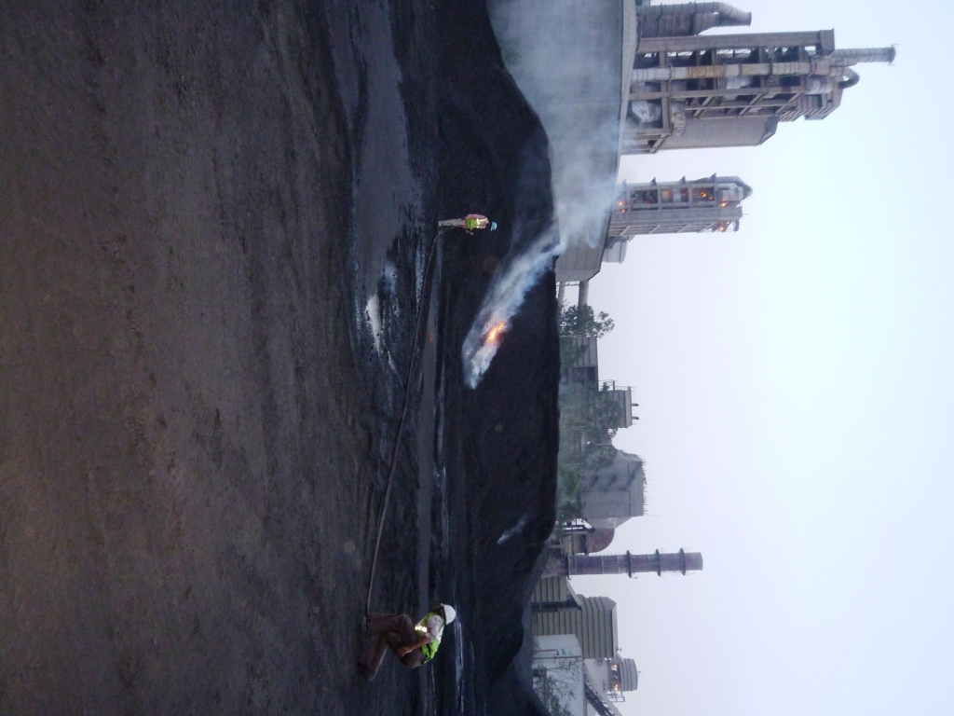
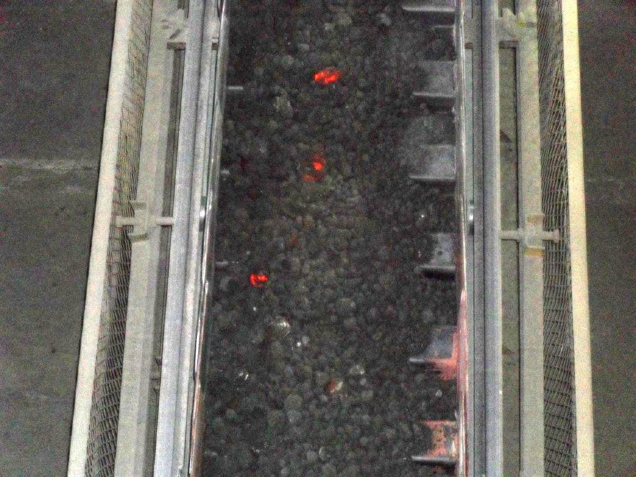
1.0 Where on the raw coal side do we have to deal with fire and explosion protection?
Smoldering & auto-ignition. Certain types of coal may start to burn in the yard.
The last thing that should happen is that the problem is transferred into the system.

Slide 7
Where on the raw coal side do we have to deal with fire and explosion protection? – 1.0₁
yard:
prevention of auto-ignition (smell & temperature monitoring
and quick response)
- stockpile management FI/FO, stockpile height, compression
prevention of tramp material and burning fuel entering the
system
pre-crusher system, if any:
explosion pressure shock resistance and explosion
venting where necessary (crusher, air filter and
connections)
explosion isolation where necessary – Think of inter-
connected equipment and paths via which flame and
pressure effects can be felt in the proximity.
belt track-to-raw coal silo(s)
meaning - transition point de-dusting
explosion pressure shock resistance and explosion
venting where necessary (air filter enclosures)
fire detection that stops the conveying to the plant
explosion isolation where necessary

Slide 8
1.1 Where in such systems do we have to deal with fire and explosion protection?
Fire and explosion protection of yard, pre-crusher system and belt track transition points often are treated not very carefully, which is understandable (although not correct) in all cases in which the raw coal normally is not causing problems.
In the real world fire and explosion protection of yard, pre-crusher system and belt track transition point dust filters often are not in place, incorrect, or incomplete.
Obviously, the parties involved often consider the raw coal part of the system as “not so much in need of protective designs”.
The least that can be said about incorrect situations is that the operation in question is not living up to its mission statement by “cutting some corners”, with most personnel not aware of this.

Slide 9
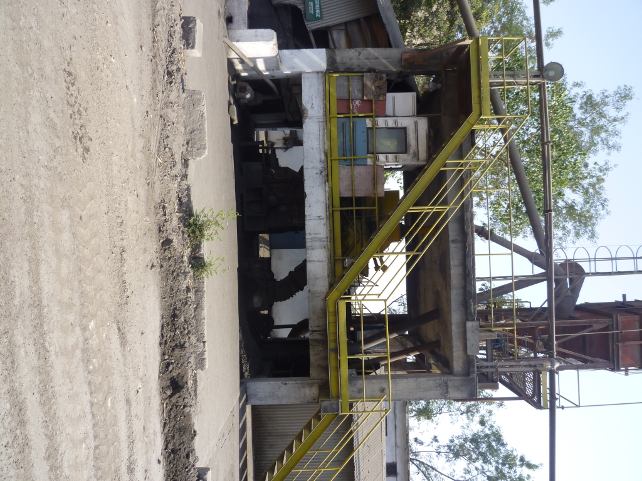
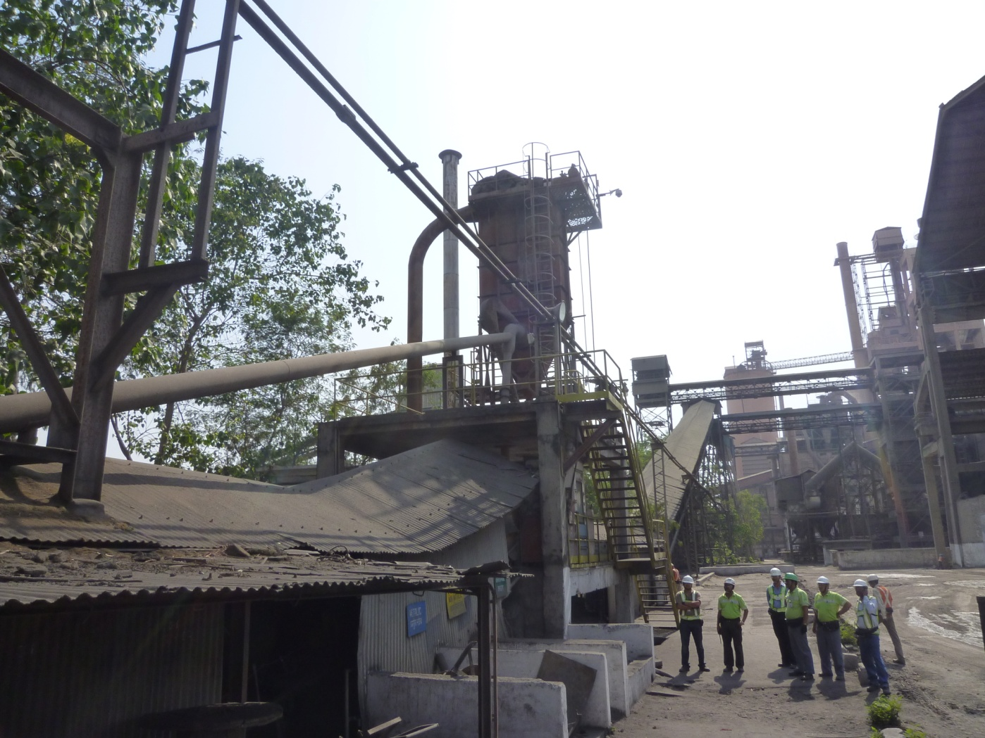
1.1₁ Where in such systems do we have to deal with fire and explosion protection?
2 – bag filter for crusher de-aeration de-dusting and belt conveyor de-dusting
In this bag filter an explosive atmosphere is normal.
And, under certain circumstances, a fire can develop in this filter.
ignition in bag filter
ignition in crusher
1 – crusher, normally an impact crusher
In this crusher an explosive atmosphere is normal.

Slide 10
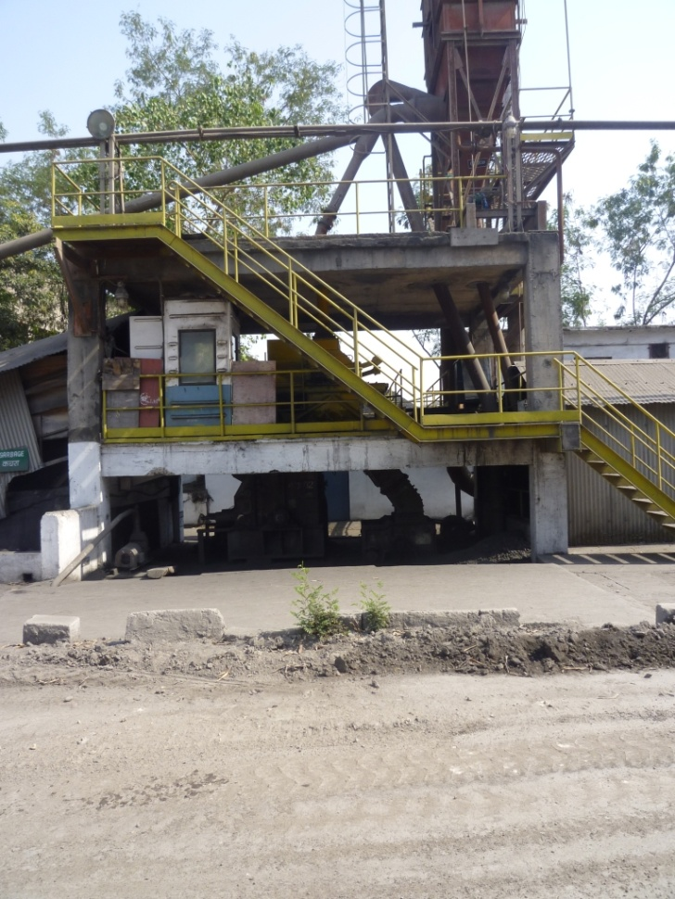
1.1₂ Where in such systems do we have to deal with fire and explosion protection?
ignition in bag filter
Crusher and de-dusting filter are interconnected vessels.
ignition in crusher
everywhere!
Due to the connections, which are many, explosion pressure or fire effects, or both, will be felt EVERYWHERE inside the whole configuration.

Slide 11
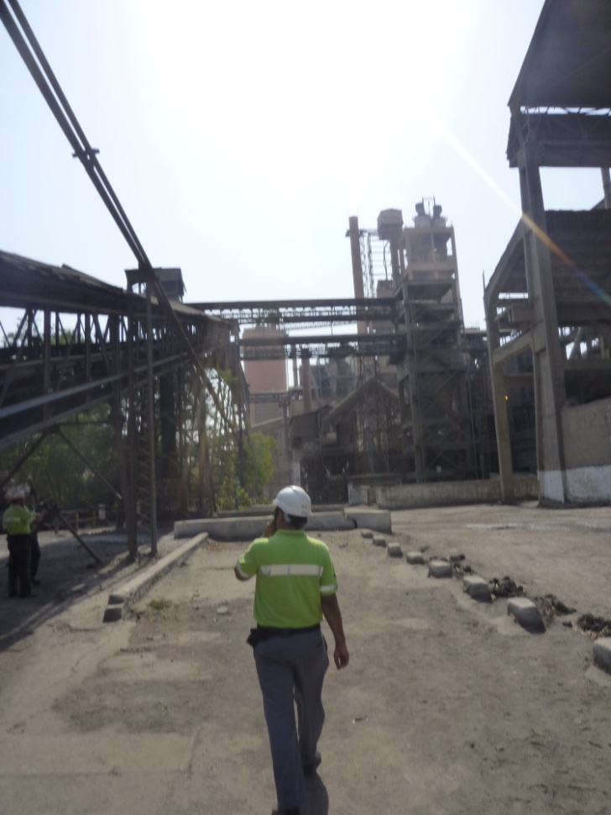
1.1₃ Where in such systems do we have to deal with fire and explosion protection?
De-dusting filters will drop their collected dust on top of the layer of material on the conveyor belt, from where it, in many cases, will be blown away by the wind.
Dust on top of the layer of material on this conveying belt is prone to be blown away.
ignition in bag filter
According to the rules, de-dusting filters need to have explosion protection included in their design,
Which is a good reason to avoid them whenever they would be useless anyway.
Such situations can be designed and realised correctly without making this expensive.
And, it is very good to ask whether de-dusting of belt transition points and drop off points makes sense in the first place.
Although the explosion protection needed for this type of equipment configuration is completely covered by EN standards (several), by NFPA standards 68 and 69, and other standards, codes, and guidelines, what will be found in the industry is normally protected incorrectly.
felt everywhere!
Most belt transition point and drop off point de-dusting filters are incorrectly protected too.
The system shown here is not correct in many ways.

Slide 12
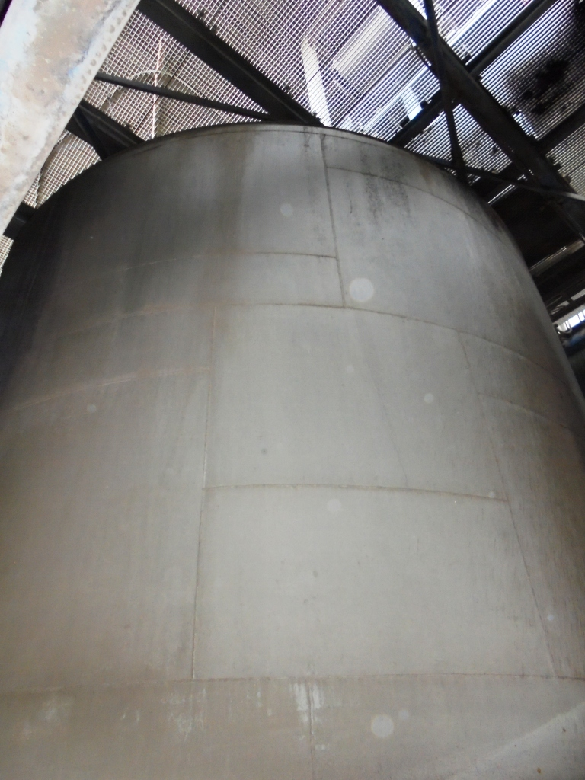
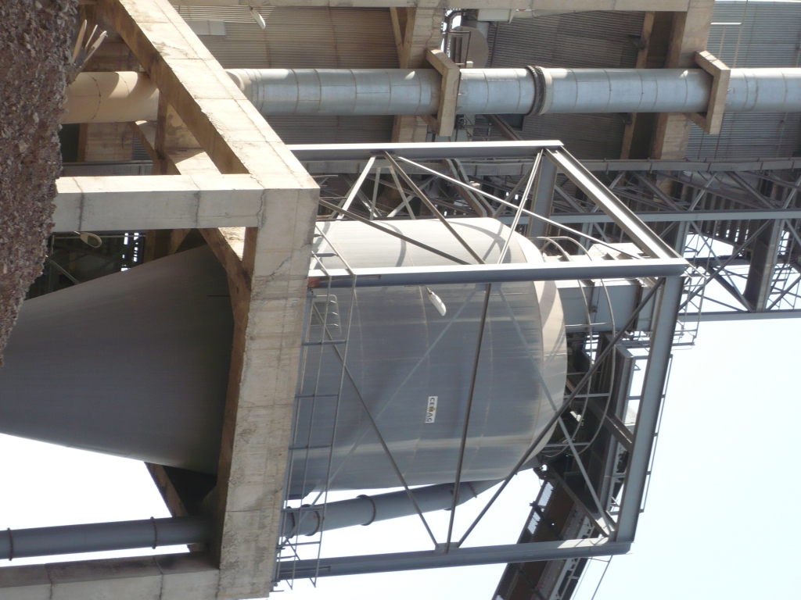
1.2 Where else on the raw coal side do we have to deal with fire and explosion protection?
end of belt track to raw coal silo(s)
Often it is “forgotten” that the de-
aeration filter of the raw coal silo
is equipment that handles ignitable
dusts.
”Forgotten” means that it is
forgotten to include appropriate
fire and explosion protection here.
Very often, raw coal silos are situated inside buildings or coal mill system structures, where they don’t belong!
Increasingly, due to incidents, users
are demanding raw coal silos with
fire and explosion protection,
which then includes the a. m.
filter.
Good cost-effective solutions exist.
They should be outside and a fire fighting strategy has to be in place.

Slide 13
2.0 optimisation of the grinding equipment configuration
Are coal mill systems in need of optimisation?
What you can expect from a good supplier is that the mill proper will be a good piece of equipment, with its design having undergone improvement over tens of years.
What you also can expect is that the process, in terms of fuel and air flow rates through the system and temperature control, will be all right. Normally also on the basis of tens of years of experience.
Standard equipment for the handling and intermediate storage of raw and processed fuels, conveying, air-dust separation, etc. is available on the market, in good quality.
So where is there room (or need) for optimisation?

Slide 14
2.1 optimisation of the grinding equipment configuration
Where does the need for optimisation come from?
Let’s speak of new fuel grinding systems here.
To understand this, let’s have a look into how, after a supplier has been selected, the purchase contract normally comes into being.
1st
A basic concept will be decided on. This concept will be based on the positions of burners and the raw fuel yard relative to each other, and the resulting conveying distances.
And, on the type of mill deemed best.
2nd
Now the supplier will typically look for a system design of which the drawings are already available, with a minimal need for design changes. Such a design will be found and then mutually accepted.
3rd
The purchasing party and the supplier agree on technical details, on the basis of each party’s knowledge and experience.

Slide 15
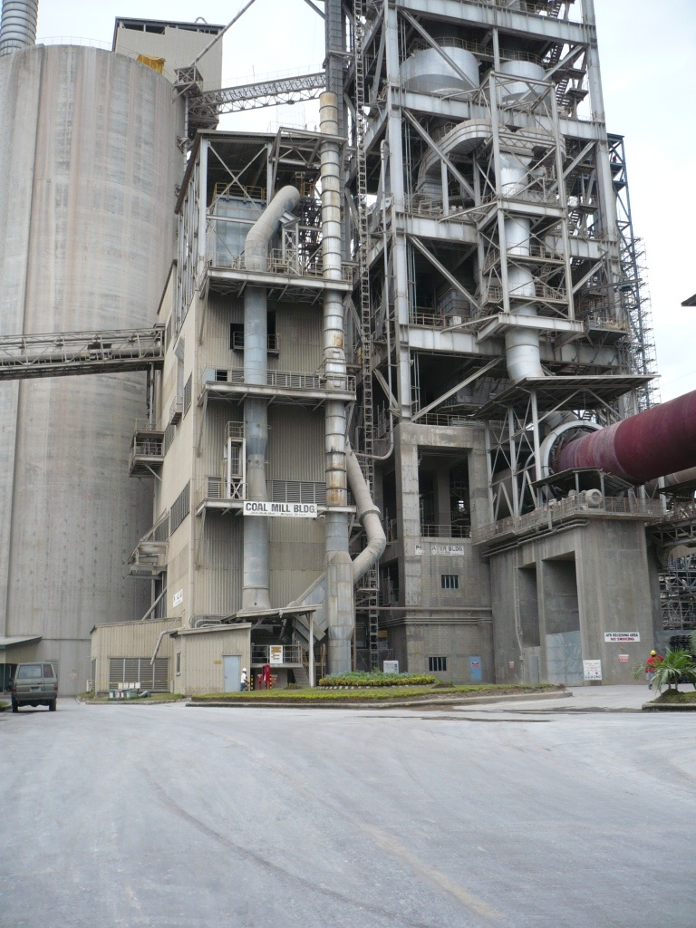
2.2 optimisation of the grinding equipment configuration
The resulting system would likely look like this:
This design can be called classical, and is typical for situations in which the PF is conveyed mechanically (or dropped) from the bag house funnel hopper into the PF silo, (or silos) underneath, which serve pre-calciner burner(s) and kiln burner.
The drawback of such designs is that they come with a lot of structure (steel and concrete), for which the costs normally are not included in the package supplied by the supplier, who will cover this part of the package mainly by supplying drawings.
Classical means that these, or similar designs, are repeated over and over again.
For now roughly 40 years!
And, the raw fuel silo and the PF silo(s) often are located inside the structure, which is not a good idea from the fire and explosion protection point of view.
As good as this may be for the suppliers’ costs, as bad is this for:
the industry’s design progress
the costs of realisation to be borne by the purchasing side

Slide 16
2.3 optimisation of the grinding equipment configuration
Here are the interconnected confined volumes between which explosion and fire effects may transit, e. g., in form of flame front propagation:
If we assume that an explosion in the raw coal silo will not affect downstream equipment, and therefore shouldn’t be mentioned here, the interconnections in need of adequate explosion isolation are:
Mill, separator and bag house are connected via a riser duct with a relatively large cross section.
3) due to the risk that an explosion is ignited in the bag house
1) due to the risk that an explosion is ignited in the horizontal ball mill:
2) due to the risk that an explosion is ignited in the separator:
Through this riser duct so called flame front propagation is possible in either direction, even against the direction of the airflow with 20 m/s.
4
1
1 raw coal silo
2 horizontal ball mill
3 separator
main bag filter
PF silo
PF dosing
3
5
2
6

Slide 17
2.4 optimisation of the grinding equipment configuration
Here are the interconnected confined volumes between which explosion and fire effects may transit, e. g., in form of flame front propagation:
Mill and bag house are connected via a riser duct with a relatively high length-to diameter ratio, which supports flame front propagation and its acceleration.
According to the rules for explosion protection, explosion isolation or explosion de-coupling has to be provided for, as part of the system design.
Mostly some explosion isolation/de-coupling is in place.
Very often system designs are incorrect in the relevant details and the operators unaware of this.
1) due to the risk that an explosion is ignited in the vertical roller mill:
2) due to the risk that an explosion is ignited in the bag house
4
3
1
1 raw coal silo
2 horizontal ball mill
3 separator
main bag filter
PF silo
PF dosing
1
1 raw coal silo
2 vertical roller mill
3 main bag filter
PF silo
PF dosing
3
5
4
2
6
2
5

Slide 18
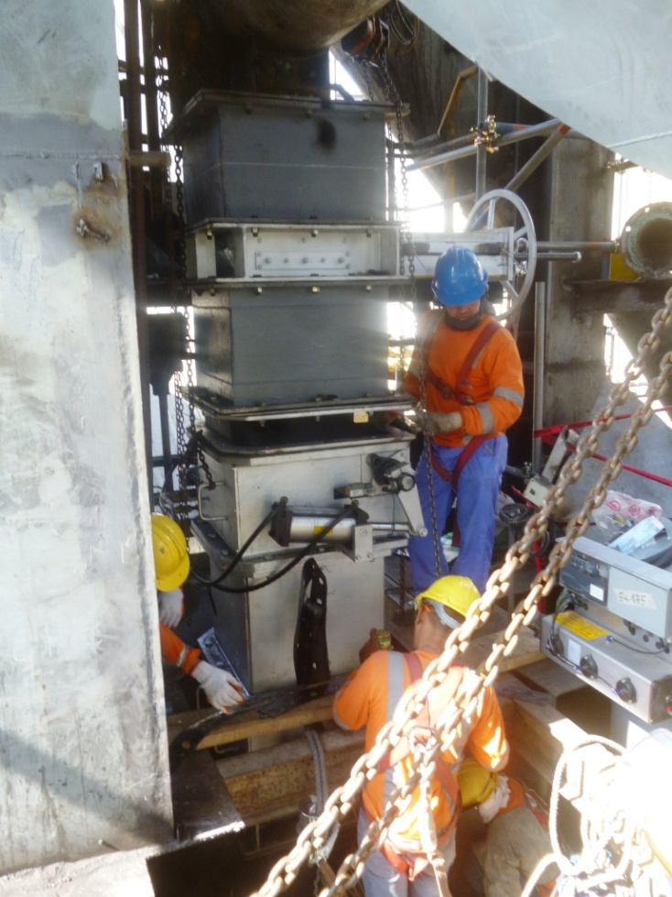
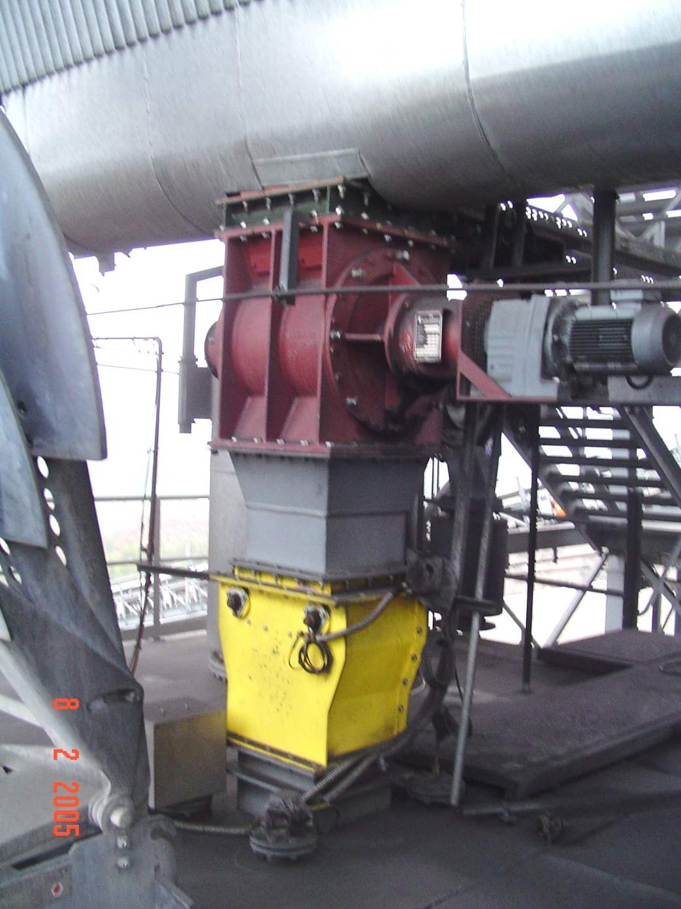
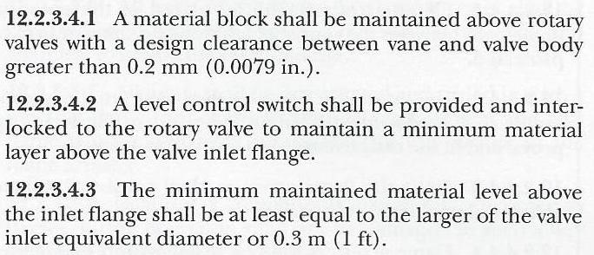
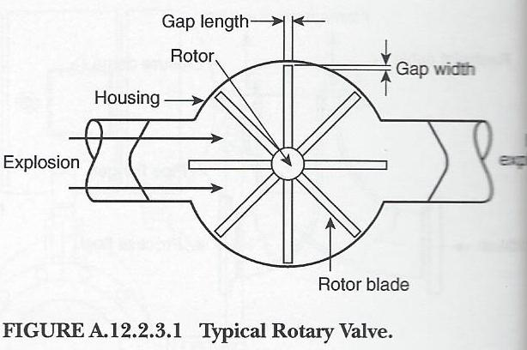
2.5 optimisation of the grinding equipment configuration
All is fine, as long as we can keep a pile of bulk above the rotary valve, as NFPA 69 and other standards say.
Certainly, in many situations, it is possible to install rotary valves with such a choke above them.
So we need explosion isolation or explosion de-coupling, respectively.
The commonly used solutions are:
1) EXPLOSION ISOLATION by means of a rotary valve
No
explosion
But to allow the building-up of a choke in the funnel hopper of a coal mill bag house certainly is not a good idea.
Gap width
Which in practise will look more like this.
And then can be made as to comply with NFPA 69 and EN 15089 and other explosion isolation standards.
And therefore, another method for explosion isolation has to be applied here.
The intensity of maintenance that would be necessary to do exactly this can be provided by certain industries. But not by the cement industry!
However!!!
However!!! Most people are unaware of what the manual of such an explosion isolating rotary lock will say:
Which is that explosion isolation only will be provided for if the a. m. gap width is kept within a small tolerance.
copied from NFPA 69, 2008 edition
Here a double flapper valve is being installed between a bag house funnel hopper and the PF silo underneath.
copied from NFPA 69, 2008 edition

Slide 19
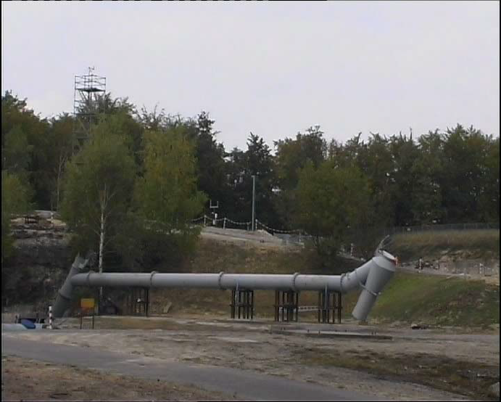
explanation of the test set-up shown
The explosion diverter at the end of the duct also diverts flames and pressure into the atmosphere, albeit with considerable less violence.
As is typical for explosion de-coupling, still flames will pass through the diverter and enter the ‘baghouse’. But what enters the baghouse is not pressurised and the normal constructional explosion protection of the baghouse will deal with a possible secondary explosion without difficulty.
In the following slide it can be seen how the explosion vent ‘close to the mill outlet’ at the left diverts explosion effects from the system into the atmosphere. The venting blast is clearly recognisable as violent.
On the left in this picture a controlled explosion in a pressure vessel simulates the explosion in a coal mill from which flame front propagation starts to run through the simulated riser duct
At the end of the duct an explosion diverter as would be positioned for the protection of a downstream baghouse is installed. No baghouse has been installed.
A test set-up with a vertical riser duct would have been unpractical.
But the horizontal configuration has the disadvantage that the dispersion of coal dust in air in the horizontal duct has to be simulated, which was done by installing a duct-internal open channel from which the explosion effects reliably dispersed coal dust ahead of the propagating flame body.
Tests done by INERIS, France, for Thorwesten Vent GmbH
Purpose: Study of the mitigation of flame front propagation through coal mill-to-bagfilter riser ducts by means of explosion diversion close to the mill outlet.

Slide 20
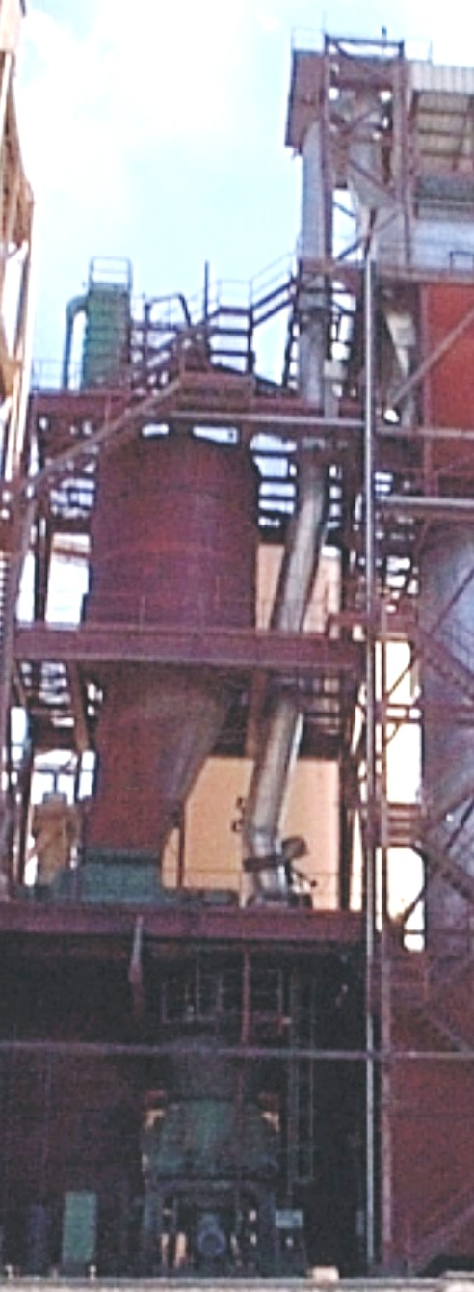
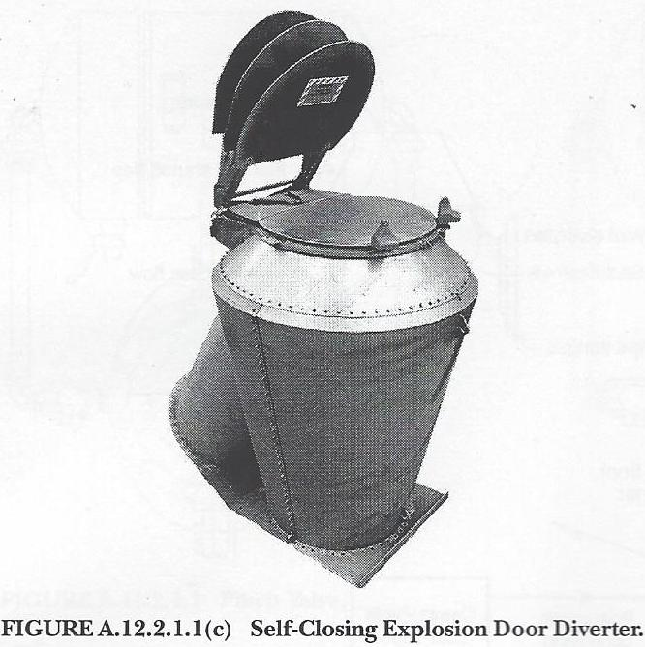
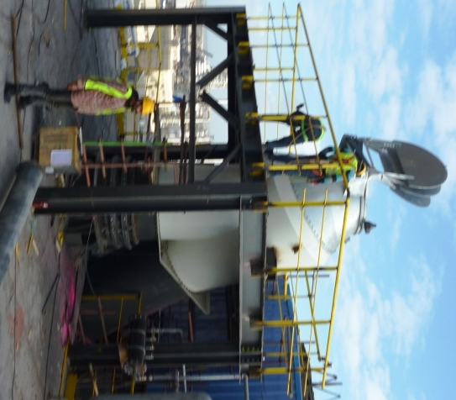
2.5₁ optimisation of the grinding equipment configuration
Example of a long mill-to-bag house riser duct
So we need explosion isolation or explosion de-coupling, respectively.
The commonly used solution is:
2) EXPLOSION DE-COUPLING by means of an explosion diverter
An explosion diverter diverts explosion effects out of a duct track, mitigating the harm they could do to equipment into which they might run. That is, primarily avoiding the havoc accelerated flame front propagation could cause.
coal mill
bag filter
Explosion diverting is a special version of explosion venting.
IMPORTANT: Self-reclosing explosion vents are necessary for diverter applications in coal grinding systems.
Open venting orifices are highly counter-productive, in terms of damage mitigation after venting.
copied from NFPA 69, 2008 edition
The use of an explosion diverter has to be in compliance with NFPA 69, EN 16020, or other applicable standards.

Slide 21
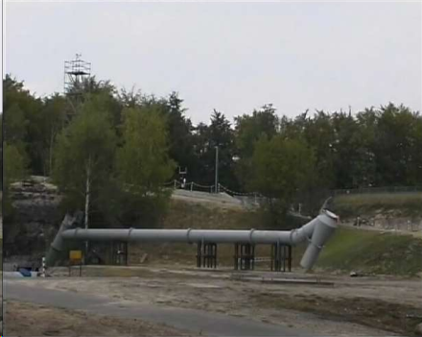
2.5₂ optimisation of the grinding equipment configuration
mitigation of the flame front propagation velocity
coal mill
bag filter

Slide 23
2.6 optimisation of the grinding equipment configuration
What has this to do with system optimisation,
or design optimisation?
Explosion vents (diverters) cannot be positioned without taking an accelerated flame front with possible velocities >200 m/s (720 km/h) into account.
The longer the riser duct between the mill and the air-PF separation facility, which is …
If duct length cannot be avoided, mitigation of possible flame front propagation effects becomes a necessity.
- just the bag house in case of a vertical roller mill installation
- a separator & a bag house in case of a horizontal ball
mill installation
Which is a reason for a good look at design configurations, in this respect.
… the higher the risk that flame front propagation through the riser duct becomes really fast.
Coal mill systems must not be towers. Long riser ducts must not be.
Just because such a design has been realised in the past and is therefore available from someone’s drawer is not a good reason to build a coal mill system in form of a tower!

Slide 24
2.7 optimisation of the grinding equipment configuration
riser duct between mill and
bag house short and straight
raw coal stockyard
raw coal belt conveyor
bag filter
Let’s go for 2 PF silos, one for each burner.
Let’s include a CO₂ system now.
minor volume of closed building and largely open, simple steel structure
The mill system has to be positioned somewhere between raw coal stockyard and the burners of kiln and pre-calciner.
This then defines the location of the raw coal silo.
Then we have the conditions for a very simple setup of the coal mill system proper.
mill
raw coal silo (bunker)
recirculating process air
Silos for raw coal and PF are not positioned inside building.
The distance between the gravimetric burner feeders and the burners has to be not too long.
Meaning that the best place for the coal mill is roughly half way the kiln length, not too far away from the kiln.
bag filter
CO₂
coal grinding system structure
mill
low O₂ process air from pre-calciner
stand alone PF silos
positive pressure pneumatic conveying systems with “pump”
gravimetric dosing & conveying
gravimetric dosing & conveying
pre-calciner burner
kiln burner

Slide 25
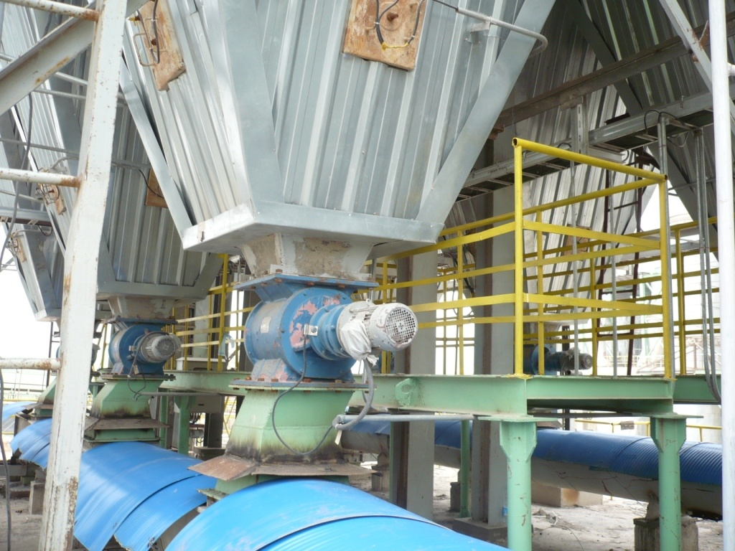
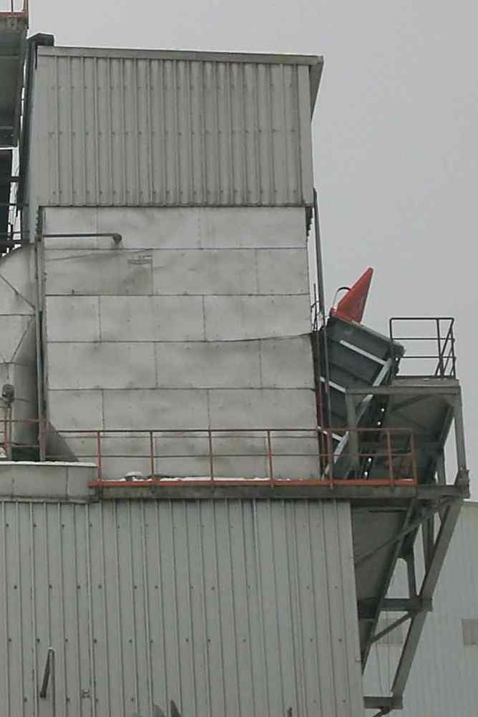
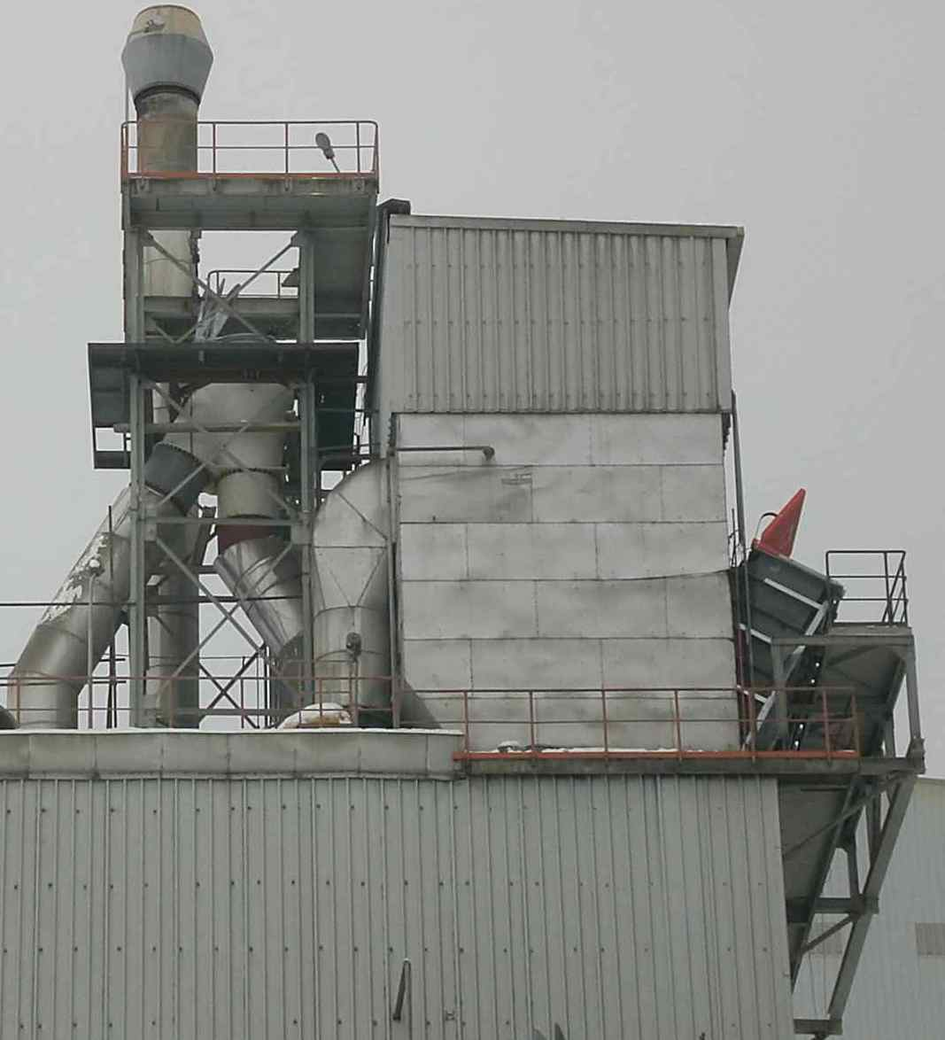
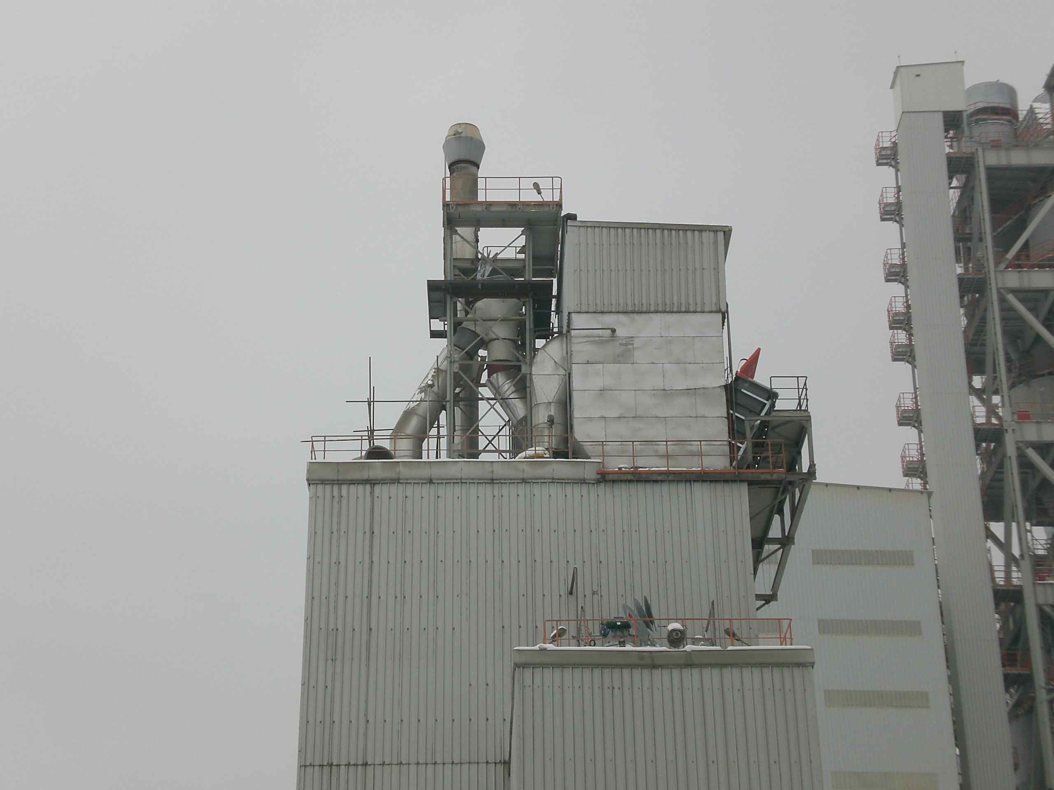
3.0 something about coal mills’ main bag houses
Using a standard modular bag house system for a fuel pulverizing process?
Most coal mill bag houses are of rectangular shape.
Forget it!
The best designers/manufacturers will get them strong enough as to survive mitigated explosion pressure of up to 400 mbar g.
The worst suppliers in this respect will not allow higher mitigated explosion pressure than 100 mbar g.
Purchasing a coal mill system without the deciders “being in the know”, regarding explosion and fire protection, especially when it comes to large filters, opens plenty of possibilities for incorrect results, not only in terms of fire and explosion protection (including emergency inerting and explosion isolation), but also regarding maintenance and access-ability for maintenance.
In order to achieve the necessary mitigation of explosion pressure, normally explosion vents will be installed.
The lower the strength of a bag house, in terms of capability to survive mitigated explosion pressure, the more explosion venting capacity has to be installed.
Since self-reclosing explosion vents are what is needed here, it makes sense to insist on bag house designs with a strength considerable greater than “good for” 100 mbar g.
The more discharge paths there are the more explosion isolation is needed, which hasn’t been understood here!

Slide 26
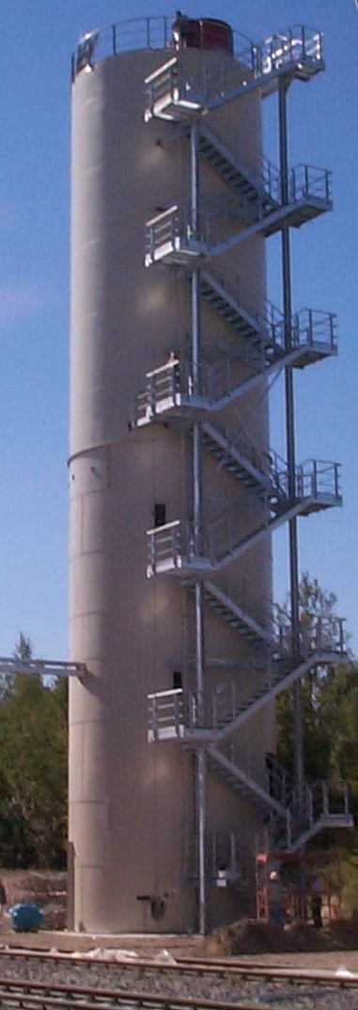
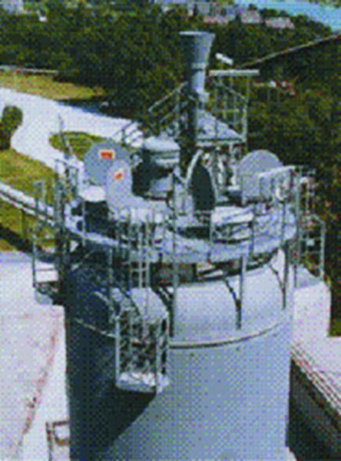
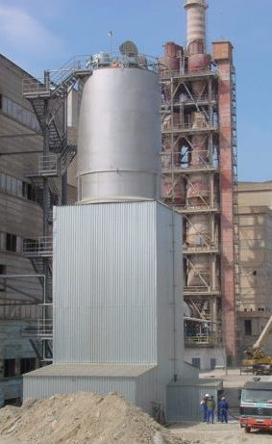
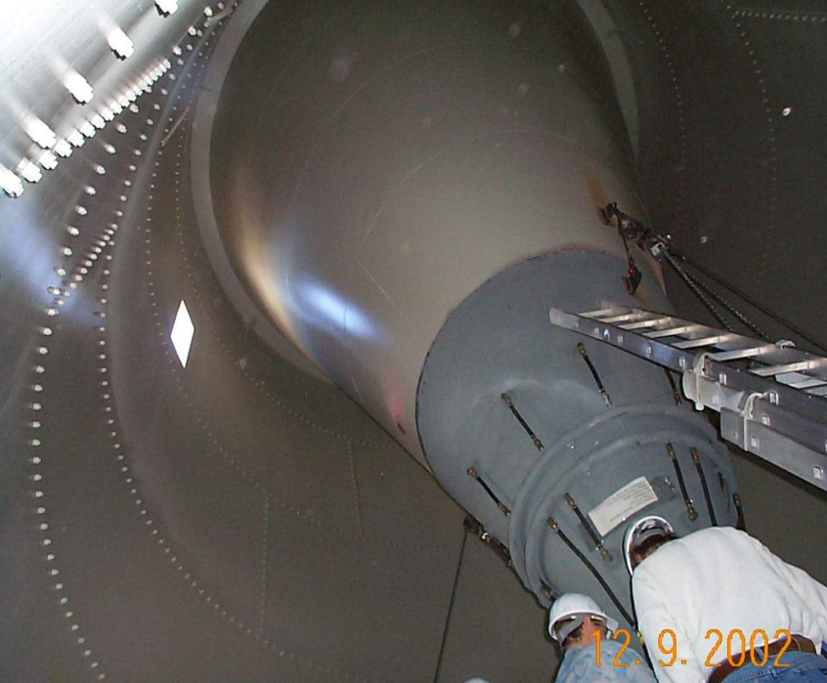
4.0₁ something about PF silos
They have the following disadvantages:
PF silos don’t belong in buildings or in more or less closed structures.
So called skirted silos have a smaller footprint and can be used if a single burner feeder system has to be housed.
Including load cells in these designs is slightly more complicated.
They have to stand alone.
The design and the fabrication of the top platform are more elaborate than the design and manufacturing of the silo hull.
The design and the fabrication of the top platform are more elaborate than the design and manufacturing of the silo hull.
For strength-related reasons all protrusions through the domed top (as necessary to install equipment on it) have to be located in the centre of the domed section.
Good designs depend on a couple of important details. The following are the issues needing special attention, when making decisions on how PF silos should be designed:
In order to have the most economical (smallest) need for explosion venting capacity, the explosion pressure shock resistance of the design has to be “good for 2 bar g”.
This value is generally accepted practise. And it is no small feat, for designers.
Undesired lengths for the connections of the top-of-silo equipment and the silo volume will have to be overcome. This is especially disadvantageous for explosion venting.
The example shown at the left is a case where more than one gravimetric burner feeder with auxiliary equipment had to be housed.
The supporting steel construction
offers the necessary space.
Which means that the centre of the top platform becomes densely packed with equipment, which hinders the necessary access for maintenance purposes.
2/3
silo diam.
Underneath the platform some very dirty corners are created. Think also of corrosion there.
In the past, often domed silo tops have been used, in order to meet the 2 bar g pressure shock resistance requirement.

Slide 27
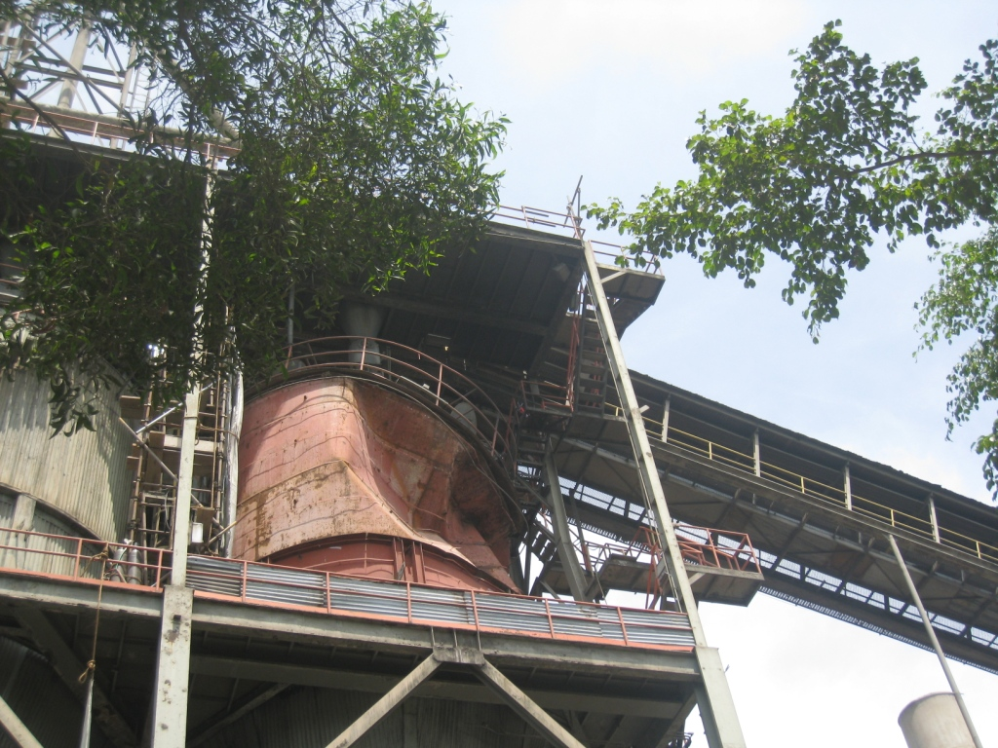
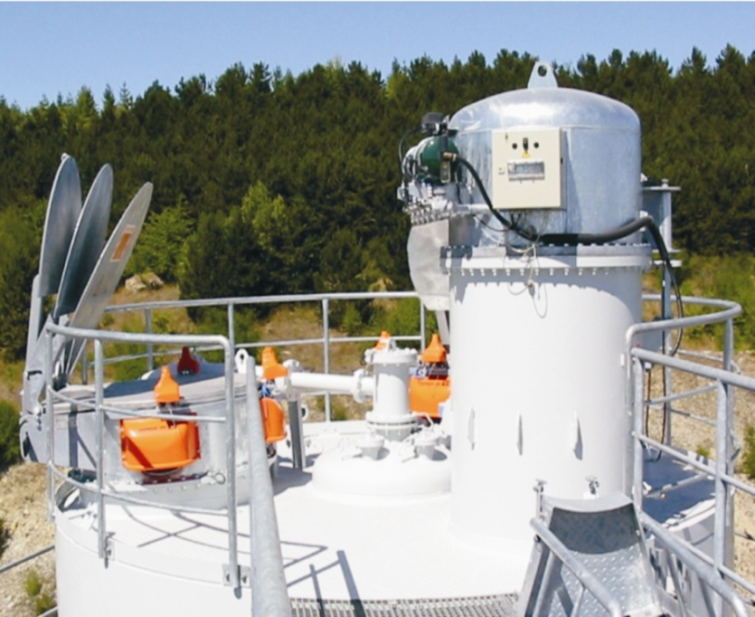
4.0₂ something about PF silos
explosion pressure shock resistance “good for”
2 bar g mitigated explosion pressure
self-reclosing explosion vents with integrated
protection of the silo against negative pressure
maintenance-friendly, silo-integrated top-of-
silo de-aeration filter
absolutely NO ROOF ABOVE THE SILO
instrumentation and interfaces for temperature,
CO & O₂ monitoring and emergency inerting
The instrumentation includes a pressure sensor
for the prevention of overpressure during
emergency inerting.
The O₂ monitoring is meaningful during
emergency inerting.
example of a well designed silo top situation, with everything in place

Slide 28
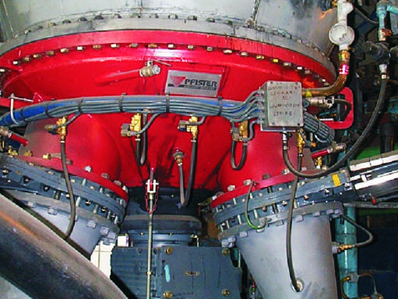
4.0₃ something about PF silos
explosion pressure shock resistance “good for”
>2 bar g mitigated explosion pressure
slowly rotating extraction aid activates large
column cross section
air injection for aeration is possible
air injection can be switched into emergency
inerting mode
temperature sensors and level switches MIN are
in place
correct explosion isolation between silo and
feeder(s) underneath is in place
example of a well designed silo extraction situation

Slide 29
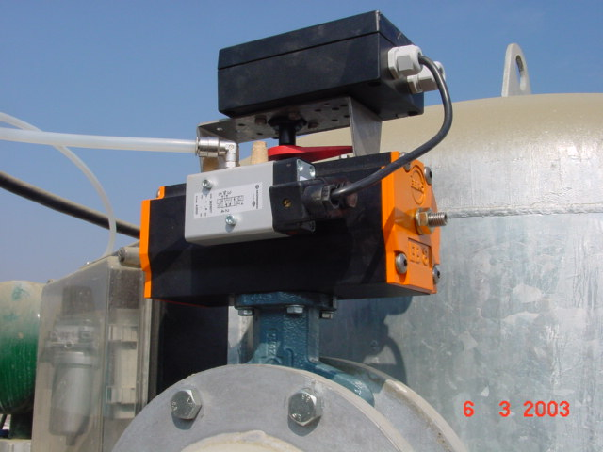
4.0₄ something about PF silos
the remote control valve in the top-of-silo de-aeration filter’s clean air exhaust with which the silo can be isolated from the atmosphere
This valve is essential for effective emergency inerting.
often not in place: This valve.

Slide 30
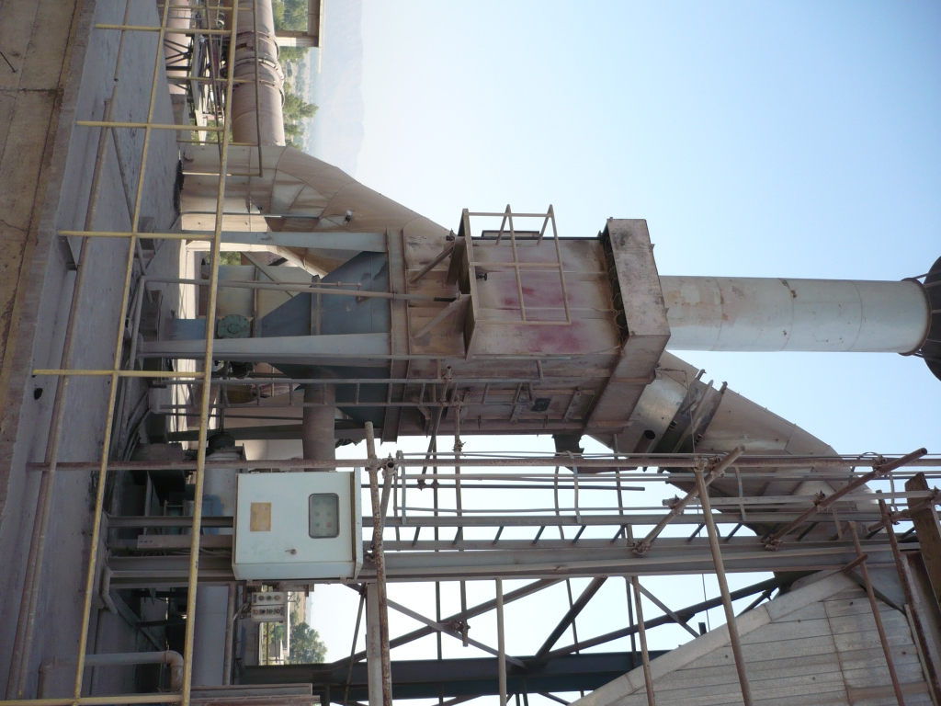
4.0₅ something about PF silos
The filter at the left is not integrated in the silo hull’s volume and therefore doesn’t have the benefit of the PF silo’s installed explosion protection working for it.
Filters which are not integrated in the silo hull volume cause a need for a considerable degree of additional explosion protection Mostly, this is missing, like here.
The photo is shown here as one example of many cases in which a relatively large, often way too large, fan is used.
The situation shown here is incorrect for more than one reason.
The little degree of explosion protection that has been installed on this filter has “fig leaf” quality at best.

Slide 31
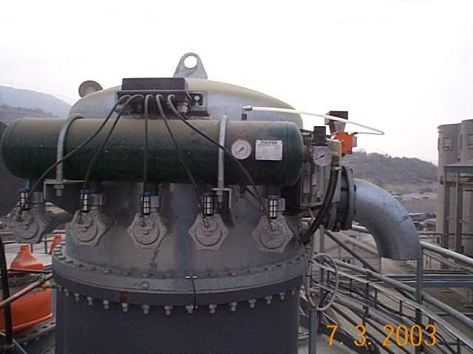
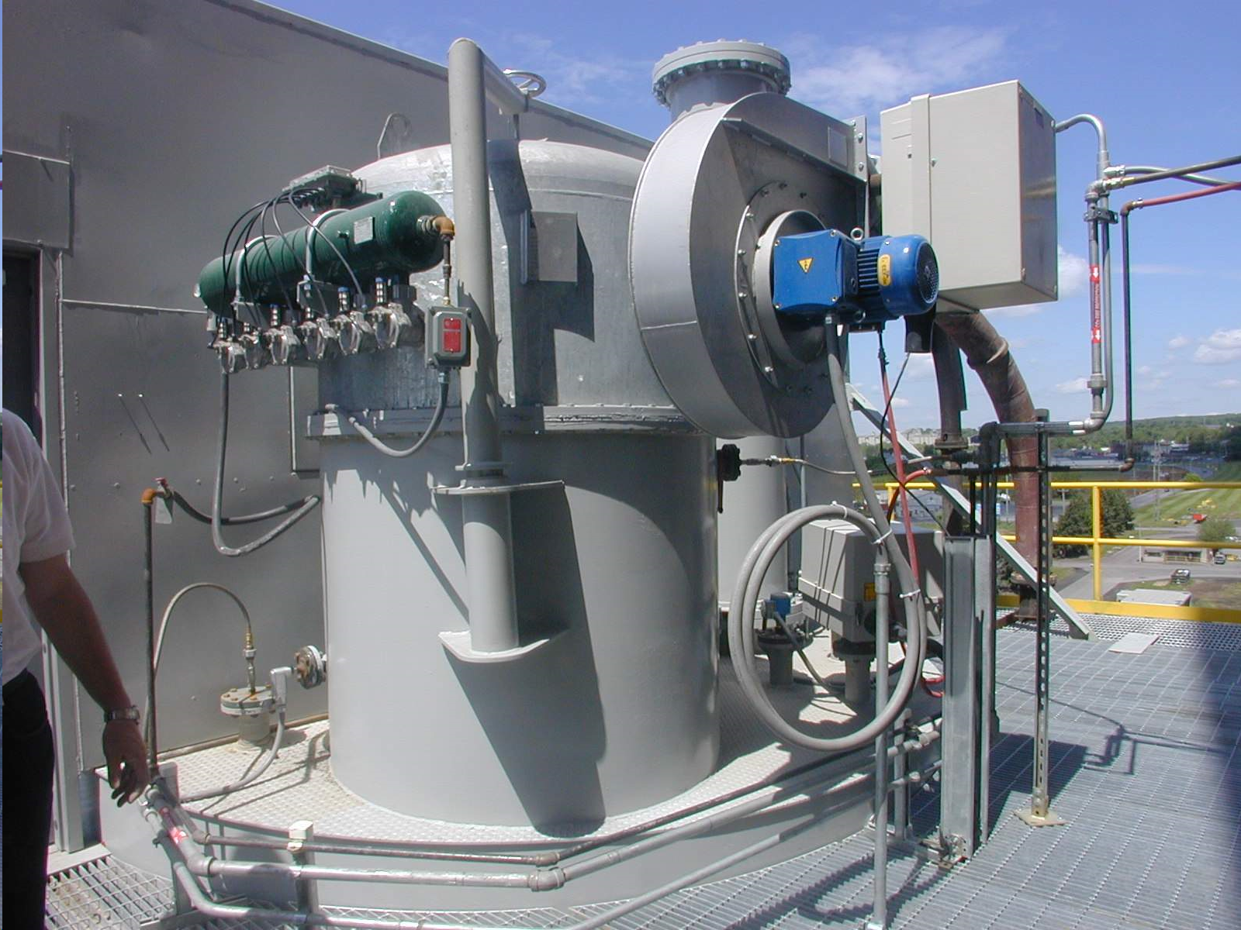
4.0₆ something about PF silos
silo volume-integrated nuisance filter for the de-dusting of the silo’s deaeration without fan
Often, a fan is not needed. Whether a fan should be used or not deserves careful consideration.
silo volume-integrated nuisance filter for the de-dusting of the silo’s deaeration with fan

Slide 32
summary
This is an effort to explain the potential of coal grinding system design to go wrong. Not only in the details of fire and explosion protection, but also in other aspects.
Due to the given time frame, the overview given here is
far from complete.
Thank you for your attention.
The potential for things to go wrong certainly has to do with the fact that standards, codes and guidelines are not covering all aspects that need to be dealt with and that it cannot be expected that everybody in the industry understands fire and explosion protection in its full complexity.
Your questions and/or comments would be highly appreciated.
Please write to info@coalmillsafety.com
Many of the photos used for this presentation kindly have been made available by Thorwesten Vent GmbH.
Just think of the confusion there exists (industry-wide) about emergency inerting, with which you may have been confronted in your own job.
the end

